Slide 1
Structure of forsterite at extreme conditions using laser shock compression
Nara Anusonti-Inthra

Slide 2
Forsterite
Main component of the mantles of rocky planets
Its phase transitions provide insight into the formation, evolution, and habitability of rocky exoplanets
Plays a role in creating and shaping convection currents, influencing factors essential to habitable surface conditions
Notes:
-very important mineral to study in the field of planetary science
-Earth’s upper mantle and expected to be in rocky exoplanets
-abundant in space: meteorites, comets, accretion disks around young stars
-phase changes drive deep earthquake generation
-but mostly: second bullet
-also affects the cooling of the early magma ocean stage of planet formation, which contributes to geochemistry and thermal evolution of a planet
-mainly, plays a role in creating and shaping convection currents -> plate tectonics and magnetosphere -> surface conditions suitable to support life
-accurate data about its phase transitions can help verify and add to theoretical models of these exoplanets
-an important phase transition that is predicted is incongruent melting

Slide 3
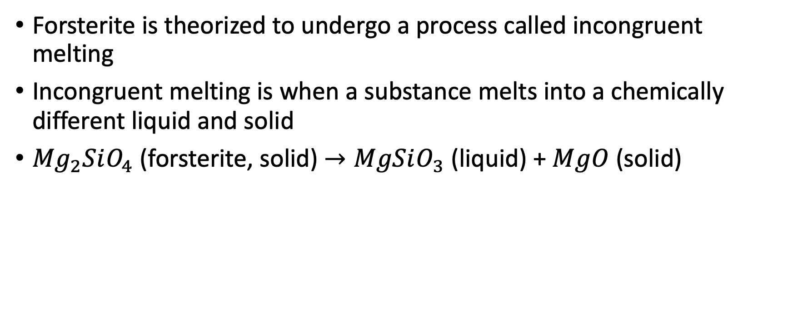
Incongruent melting
Forsterite is theorized to undergo a process called incongruent melting
Incongruent melting is when a substance melts into a chemically different liquid and solid
${Mg}_{2}SiO_{4}$ (forsterite, solid) $→MgSiO_{3}$ (liquid) + $MgO$ (solid)
Notes:
-studying the phase transitions of forsterite
-this is just one of the possible ways forsterite will behave
-we are looking for crystal MgO in our experiment
-

Slide 4
Previous studies
Evidence supporting incongruent melting has been found in only two studies, but when it occurs is currently inconclusive
Sekine et al. (2016) – found slope changes in the hugoniot (pressure v density) attributed to incongruent melting at 271 to 285 GPa
Root (2018) – attempted to replicated Sekine et al. but did not get the same results
Newman (2018) – used X-ray diffraction and found evidence for incongruent melting at 150 to 195 GPa
Notes:
-Sekine measured the density for the hugoniot, and attributed slope changes to incongruent melting
-Root suggested that the pressure range found in Sekine is too high and suggested using X-ray diffraction
-X-ray diffraction is more accurate because it actually measures the crystal structure of the sample, which is more reliable than just a density measurement
-Newman’s dissertation used x-ray diffraction and found evidence at a lower pressure
-therefore this current experiement attempts to investigate this by using x-ray diffraction and conducting experiments at 150 and 260 GPa

Slide 5
Laser shock compression
The extreme pressures needed for this experiment are generated using laser produced shock waves
The sample consisted of a 150 𝜇𝑚 thick Kapton ablator, 130 𝜇𝑚 of powdered forsterite, and 100 𝜇𝑚 of window material (LiF)
As the laser hits the sample, the ablator expands backwards, creating a uniform shock wave through the sample
Notes:
-the laser we use is the Omega-EP laser from the Laboratory for laser Energetics in Rochester
-window is used for VISAR shock wave velocity measurements (not applicable now)
-demonstrate with the picture
-the ablator evaporates, expanding backwards to create a shock wave to reach the high pressure and temperatures

Slide 6
PXRDIP
Powder X-ray Diffraction Image Plates
X-rays are diffracted according to the structure of the sample, and then picked up by the image plates
The sample is held by a Ta (tantalum) pinhole, which is used for proper data alignment
Notes:
-PXRDIP stands for … and is used for determining the structure and composition of the sample
-a laser generated Copper plasma sends x-rays through the sample after the shock wave
-these x-rays are diffracted according to structure and picked up by the box of image plates
-the sample is held in a tantalum pinhole, which focuses the x-rays on the sample and helps align the data
-x-rays from tantalum diffracting can also be seen on the PXRDIP, and as the way ta diffracts is well known and measured, the data can be calibrated properly

Slide 7
PXRDIP analysis
After integration along the azimuthal angle, diffraction peaks are found
Diffraction peaks are translated into d-spacing (inter-atomic spacing in the lattice)
Each material has a characteristic d-spacing and diffraction pattern
Notes:
-the raw data is dewarped to a polar view
-after it is aligned with the flags it is integrated up and down to find the diffraction peaks, which is where the x-rays are concentrated due to the crystal structure
-because we used a powder they show up in these lines
-after the 2-theta location is found it’s translated to d-spacing
-once you have the diffraction peaks you must identify what material it belongs to
-each material has its own unique d-spacing and diffraction pattern, crystal diffraction and d-spacing plots were used to identify each peak

